Slide 1

Balanced Banana
A Task Scheduling Solution
By Christopher Homberger, Jonas Seiler, Niklas Lorenz, Rakan Al Masri and Thomas Häuselmann

Slide 2
Overview
Initial Problem
Our goals for Balanced Banana
What Balanced Banana does
Software Structure
Unimplemented Features
Development Process
Demonstration

Slide 3
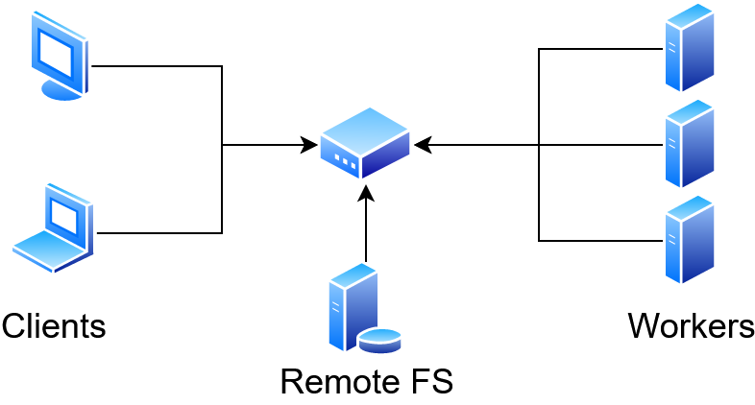
Initial Problem

Slide 4
Initial Problem
Which machine is idle?
Jobs might not need all resources of a machine
Jobs can starve
Redistribution of resources is time consuming
Jobs might require different operating systems

Slide 5
Our goals for Balanced Banana
Run a job with a single command from the shell
Get rid of all mentioned problems:
  Which machine is idle? -> Keep track of machines and jobs
  Jobs might not need all resources of a machine -> Assign only part of a machine to a job
  Jobs can starve -> Fair scheduling
  Redistribution of resources is time consuming -> Encapsulate jobs to swap them easily
  Jobs might require different operating systems -> Run jobs in virtual environments

Slide 6
Containerization
Light weight VMs (share Kernel with host)
Can be limited in resources
Contained OS can vary from Host (As long as the Kernel is the same)

Slide 7
What Balanced Banana does
Allows users to create, observe and cancel jobs
Prioritize jobs based on urgency
Resources for a job can be specified in:
  Ram
  CPU count
  Operating System
Notifies user when the job is finished
Gives access to the standard output stream
Split into 3 different executables

Slide 8
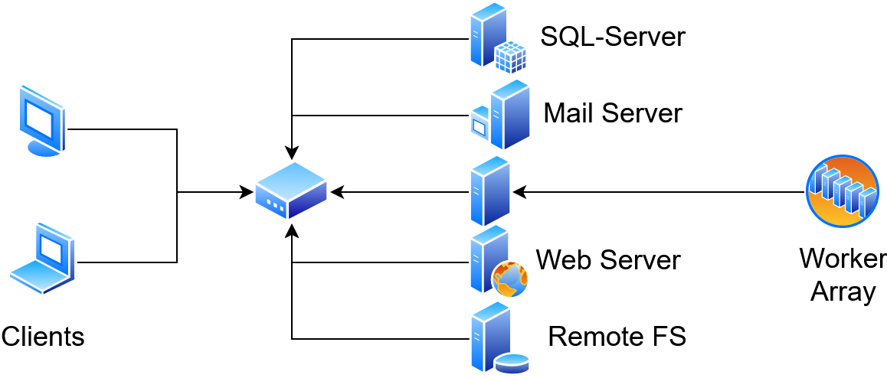
System Structure

Slide 9
Examples
bbc run --server localhost -j “compute something”
  The job ID is: 1234
bbc status 1234
  The job has been finished
bbc tail 1234
  Hello World

Slide 10
Feature: Pausing
Using experimental Docker features
Pause job to free resources
  Manually done by the user
  Emergency scheduling
Cancel job
(Creating Backups of jobs)

Slide 11
Not Implemented Features
ETA calculation
Automatically pause time intensive jobs

Slide 12
Software Structure
3 separate executables
  Worker: bbd
  Scheduler: bbs
  Client: bbc

Slide 13
Development Tools
Git + Github (https://github.com/balancedbanana)
Circleci, Travis-ci
Language: C++ 17
cmake
IDEs: VS Code, Clion
Compilers: gcc, clang + address sanitizer

Slide 14
External Dependencies
Qt5 (SQL)
CLI11
OpenSSL
SimpleHttpServer (developed by Christopher)
Docker
Cereal (Serialization)
Checkpoint/Restore In Userspace (CRIU)
GoogleTest (framework for unit tests)
Python (testing)

Slide 15
Demonstration Setup
1VM running:
  Arch Linux
  SQL Database
  Scheduler
  1 Worker
  Client “arch”
1VM running:
  Ubuntu
  Client “niklas”
Containers running CentOS

